Slide 1
Star-Galaxy Separation in EDFS
Preliminary photometry using LSSTComCam + Euclid
Kayleigh Excell, UW Madison
10 Sep 2025

Slide 2
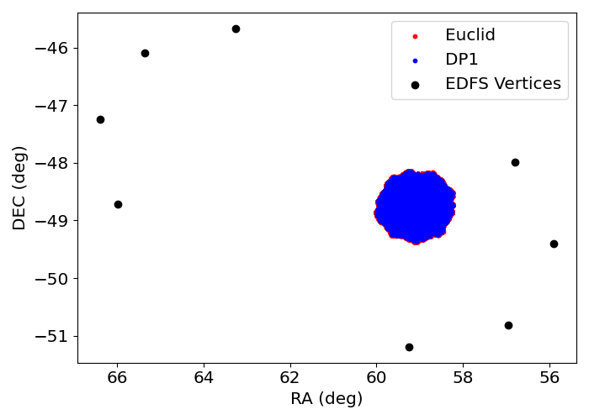
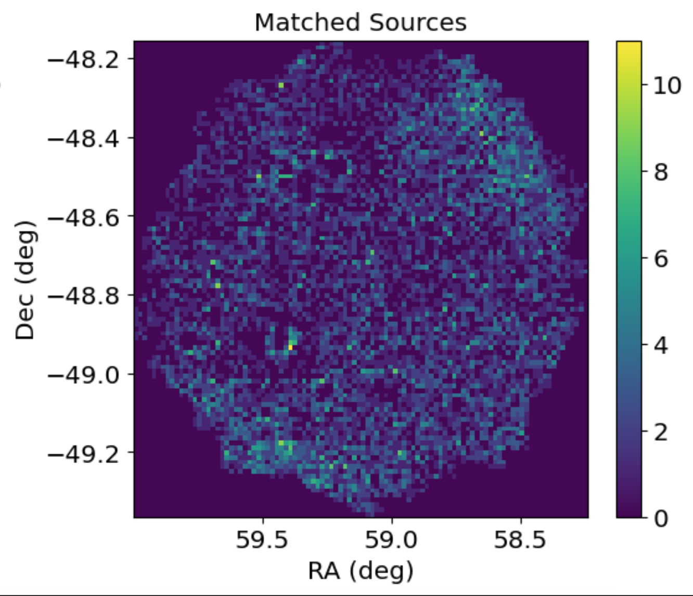
Merged Rubin-Euclid EDFS Catalog
Peter Ferguson uploaded the Euclid data which overlapped DP1 to USDF
Queried DP1 coadd object catalog within Euclid Deep Field South (EDFS)
Created a geometric mask to select only the region of EDFS that overlaps DP1 (Euclid’s EDFS is ~20 deg²)
Spatial match of Euclid objects to DP1 objects -> merged catalog

Slide 3
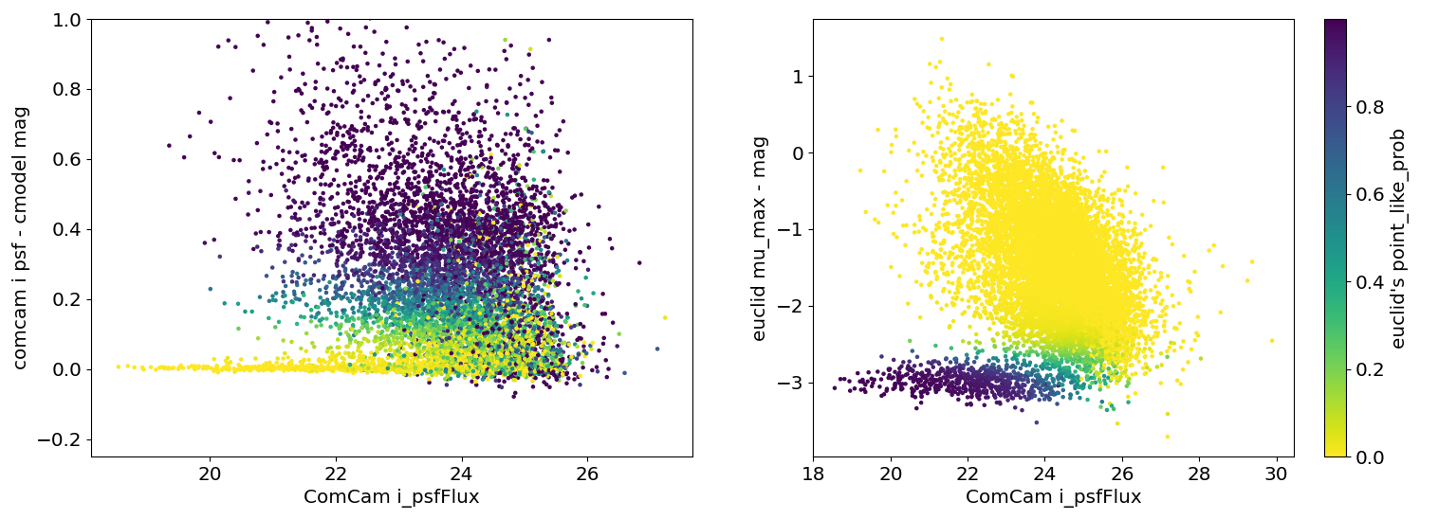
Star-Galaxy Separators
According to Euclid documentation: “Notice that this classifier (POINT_LIKE_PROB) is heavily biased towards a high purity, and thus has a low completeness.”
MUMAX_MINUS_MAG = The difference between MU_MAX (Peak surface brightness above the background in the detection band (directly from SExtractor))and MAG_STARGAL_SEP (Magnitude used to compute POINT_LIKE_PROB)

Slide 4
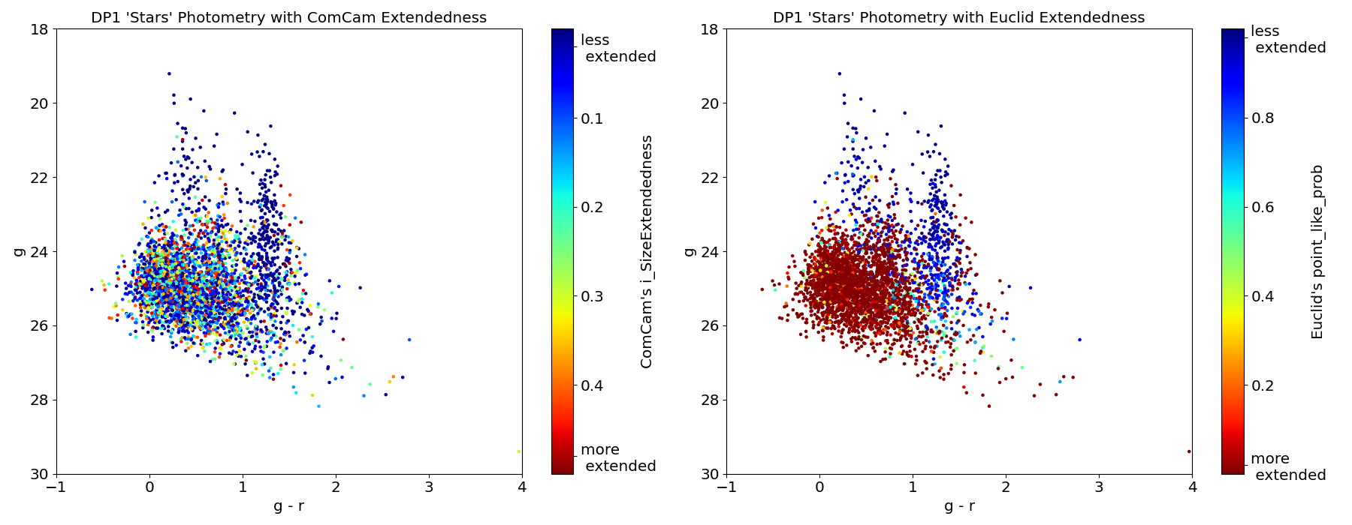
Color-Magnitude of ComCam Stars
For ComCam’s stellar sample (selected with ‘i_SizeExtendedness’<0.5)
->Euclid’s ‘POINT_LIKE_PROB’ shows distinct star and galaxy loci in color-magnitude space better than ComCam’s ‘i_SizeExtendedness’, especially for faint objects (g > 24)
-> Euclid shows that a large fraction of the ComCam-selected “stellar sample” is actually misclassified galaxies, especially for g > 24 & g - r < 1

Slide 5
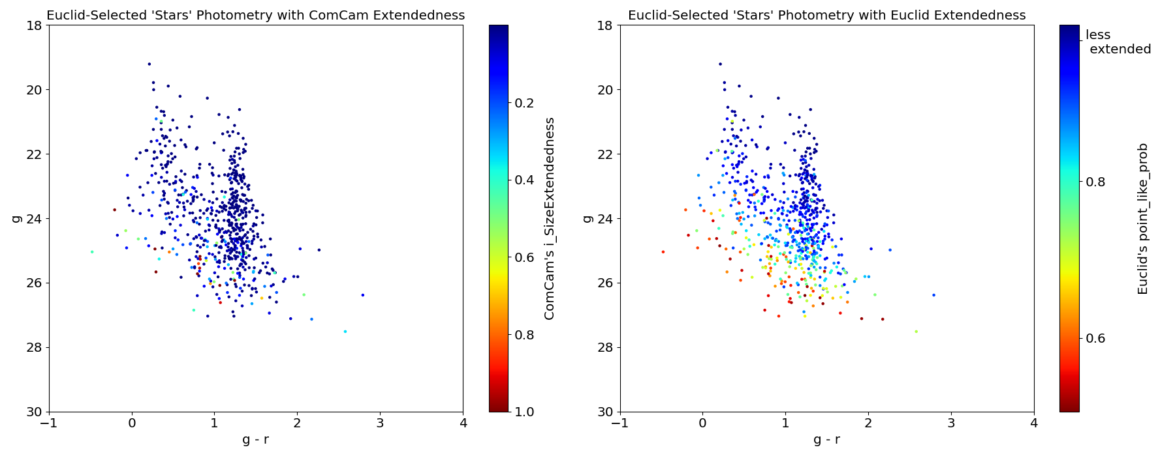
Color-Magnitude of Euclid Stars
Same process as previous slide but now using Euclid selection (‘POINT_LIKE_PROB’>0.5)

Slide 6
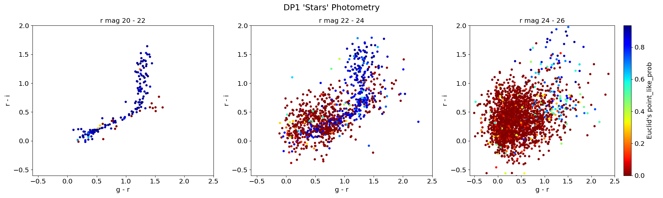
Color-Color at different magnitudes
Again, ComCam-selected stellar sample (i_SizeExtendedness < 0.5)
-> Based on Euclid’s extendedness classification, the bright magnitudes are good at having only stars, 24-26 has mostly galaxies

Slide 7
Summary and Next Steps
It seems (at least in the short-term) Euclid’s POINT_LIKE_PROB has higher purity than ComCam’s {band}_sizeExtendedness
Applying code to analyze data from LSSTCam observations of EDFS and ECDFS (currently only available to members of Project team)
Developing a stellar selection that optimally combines data from Euclid and Rubin
Using classifications from Euclid to improve and more fully characterize the stellar selection from Rubin
Perhaps Rubin is more complete but Euclid more pure
Analysis notebook: https://github.com/keexcell/star-gal_sep
Cleaning this up with documentation for those interested
Currently running on USDF. Could get this working on NERSC if we upload Euclid data to NERSC too

Slide 8
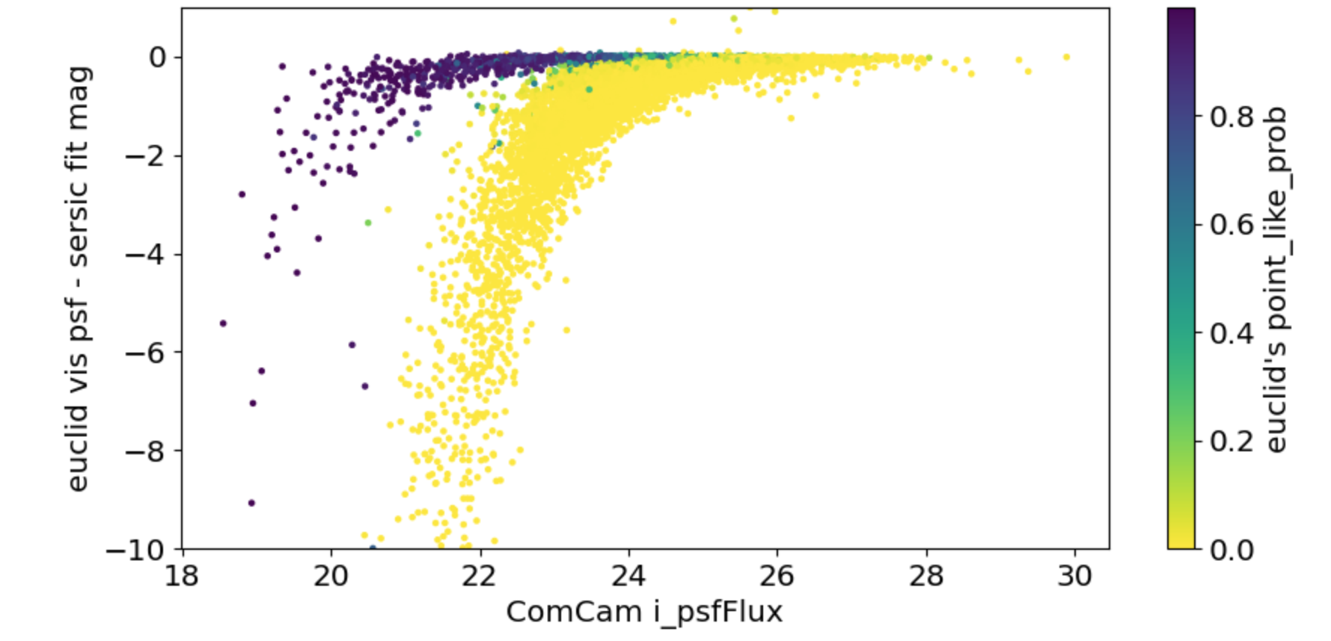
Extra plot (more of a question)
Based on how I understand Comcam’s star-galaxy sep (i band psf mag - cmodel fit mag), this is the Euclid equivalent (vis band psf - sersic fit mag).
However, what I showed on the previous slide is what their documentation pointed to for S-G sep

